Slide 1

CHAPTER 04
Linear Transformation

Slide 2
MAPPING
Define that mapping of T from V (vector space) to W (vector space) as;
T : V →W
This is a standard terminology, for such function;
V is called domain of T, and
W is called codomain of T.
if v is in V and w is in W such that;
T(v) = w
Then w in called the image of v under T. The set of all images of
vectors in V is called the range of T, and the set of all v in V such
that T(v) = w is called the preimage of w.

Slide 3
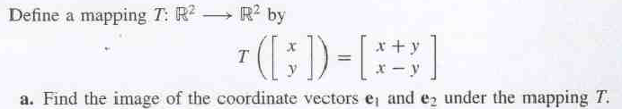
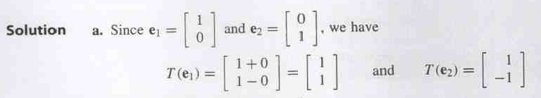
Example 1

Slide 4
Example 2
For any vector v = (v₁, v₂) in R², let T:R² → R²
defined by
T(v₁, v₂)= (v₁ - v₂ , v₁ + 2v₂).
a). Find the image of v = (-1,2).
b). Find the preimage of w =(-1,11).

Slide 5
SOLUTION
a). For v = (-1,2) we have
T(-1,2) =(v₁ - v₂ , v₁ + 2v₂) = (-3,3).
b). If T(v) = (v₁ - v₂ , v₁ + 2v₂) = (-1,11)
v₁ - v₂ = -1
v₁ + 2v₂ = 11
this system of equation has a unique solution :
v₁ = 3 and v₂ = 4 .
So the preimage of (-1,11) is set in R² consisting of the single vector (3,4).

Slide 6

Definition
Let V and W be vector spaces.
The function of T:V →W is called a Linear Transformation of V into W if the following two properties are true for all
and for any scalar c.
(i) T(u + v) = T(u) + T(v)
[T(u + v): addition in V]
[T(u) + T(v) :addition in W]
(ii) T(cu) = cT(u)
[T(cu): scalar multiplication in V]
[cT(u) : scalar multiplication in W]
(iii) T(cu + v) = cT(u) +T(v)
In the case which V = W, then T is also called a Linear Operator.

Slide 7
Example 3
Show that
T(v₁, v₂)= (v₁ - v₂ , v₁ + 2v₂),
is a Linear Transformation from R² into R²

Slide 8
Solution
Let v = (v₁,v₂) and u = (u₁,u₂) be vectors in R² and
let c be any real number. Then construct the
following;
Because u + v = (u₁,u₂) + (v₁,v₂)
= (u₁+ v₁ , u₂ + v₂), we have
T(u+v) = T(u₁+ v₁ , u₂ + v₂)
= ((u₁+ v₁)- (u₂ + v₂), (u₁+ v₁) + 2(u₂+ v₂))
=((u₁- u₂ )+ (v₁ - v₂ ), (u₁+ 2u₂ )+ (v₁+2v₂))
=(u₁ – u₂ , u₁ + 2u₂)+(v₁- v₂, v₁ + 2v₂)
=T(u) + T(v)

Slide 9
Solution (cont..)
2. Because cu = c(u₁,u₂) = (cu₁,cu₂) , we have
T(cu) = T(cu₁ , cu₂)
= (cu₁ - cu₂ , cu₁+ 2cu₂)
= c(u₁ - u₂ , u₁+ 2u₂)
= cT(u).
So, T is a linear transformation.

Slide 10
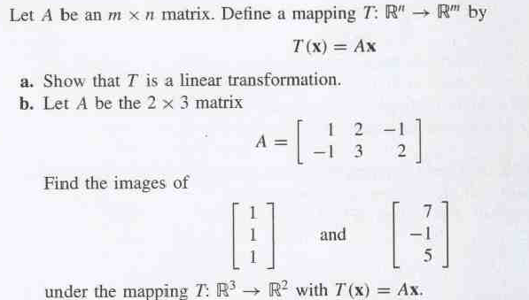
Example 4

Slide 11
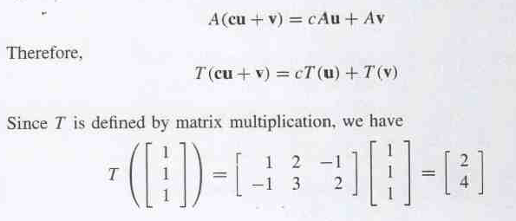
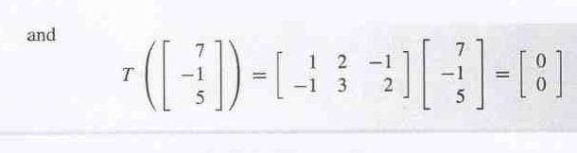
Solution

Slide 12
Example 5
Most of the common functions studied in calculus are not linear
transformation.
a). f(x) = sin x is not a linear transformation from R into R because in general : sin(x₁ + x₂) ≠ sin(x₁) + sin(x₂)
b). f(x) = x² not a linear transformation from R into R because in general: (x₁ + x₂)² ≠ (x₁²+ x₂²)
c). f(x) = x + 1 is not linear transformation from R into R because
f(x₁ + x₂) = x₁ + x₂ + 1
whereas f(x₁) + f(x₂) = x₁+x₂+2,
which is f(x₁ + x₂) ≠ f(x₁) + f(x₂).

Slide 13
Remarks
Two simple linear transformations are the zero transformations
and the identity transformation, which are defined as follows:
T(v) = 0 for all v (Zero transformation (T : V → W))
(In general, zero transformation is the transformation T: R^{n} → R^{m} that maps every vector v in R^{n} to zero vector in R^{m})
T(v) = v for all v (Identity transformation (T : V → V))
(In general, identity transformation is the transformation T: R^{n} → R^{n} that maps every vector v into itself)

Slide 14
Properties of Linear Transformations
Let T be a linear transformation from V into W, where u and v are in V. Then the following properties are true:
T(0) = 0
T(-v) = -T(v)
T(u - v) = T(u) – T(v)
If v = c₁v₁ + c₂v₂ + . . . +c_{n}v_{n},
  then T(v) = T(c₁v₁ + c₂v₂ + . . . +c_{n}v_{n})
  = c₁T(v₁) + c₂T(v₂) + . . . . + c_{n}T(v_{n}).

Slide 15
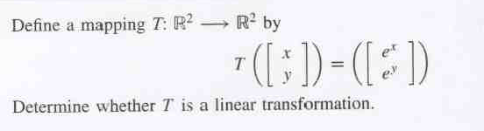
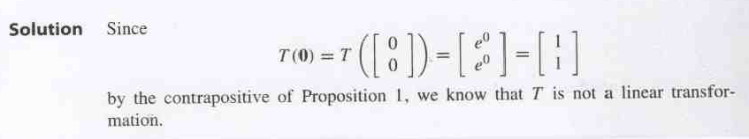
Example 6

Slide 16
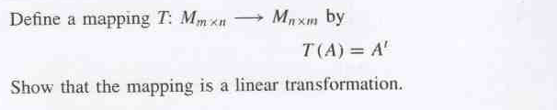
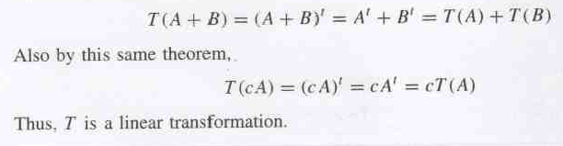
Example 7
Solution:

Slide 17
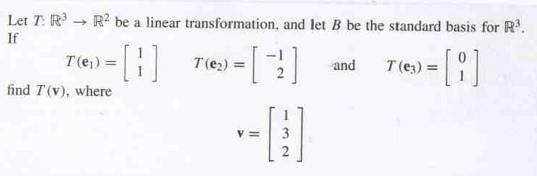
Example 8

Slide 18

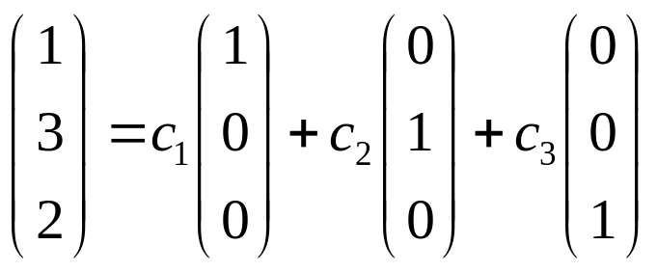
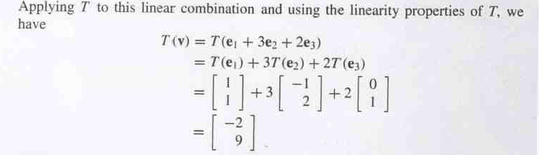
Example 8(Sol.)
Solution
To find the image of vector v, we need to write the vector as a linear combination of the basis vector.
  Thus c₁= 1, c₂= 3,c₃= 2

Slide 19
Exercises
Find (a) image of v, and (b) preimage of w for the following;
1). T (v₁,v₂) = (v₁+v₂, v₁-v₂),
v = (3,-4), w = (3,19)
2). T (v₁,v₂,v₃) = (v₁ - v₂, v₁ + v₂, 2v₂),
v = (2,3,0), w = (-11,-1,10)

Slide 20
The Null Space (kernel) and Range
Definition
If T:V → W is a linear transformation, then the set of vectors in V that T maps into 0, is called kernel (or nullspace) of T denoted by ker(T), or
ker(T) = {v Є V|T(v) = 0} or N(T) = {v Є V|T(v) = 0}
The set of all vectors in W that are images under T of at least one vector in V is call the range of T; denoted by R(T), or
R(T) ={T(v) | v Є V}

Slide 21
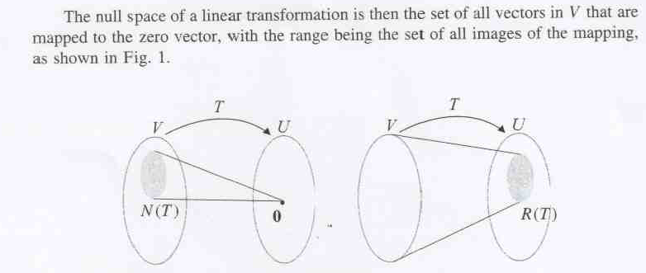
Figure 1

Slide 22
Example 9
Find the kernel of linear transformation T:R² → R³ represented by T(x₁, x₂) = (x₁ – 2x₂, 0, -x₁)
Solution:
To find ker(T) we need to find all x = (x₁,x₂) in R² such that,
T(x₁, x₂) = (x₁ – 2x₂, 0, -x₁) = (0,0,0)
this lead to the homogenous system
x₁ - 2x₂ = 0, 0 = 0, and -x₁ = 0
Which lead the trivial solution (x₁,x₂) = (0,0), so we have
ker(T) = {(0,0)} = {0}.

Slide 23
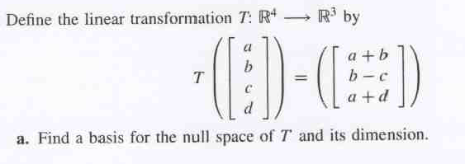
Example 10

Slide 24
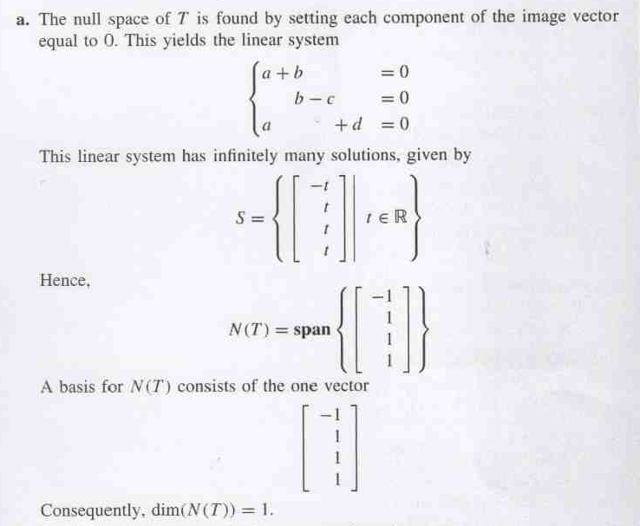
Solution

Slide 25
Theorem
Let V and W be finite dimensional vector spaces and B = {v₁, v₂, …,v_{n}} be a basis of V. If T:V→W is a linear transformation, then
R(T) = span { T(v₁), T(v₂),…, T(v_{n}) }
25

Slide 26
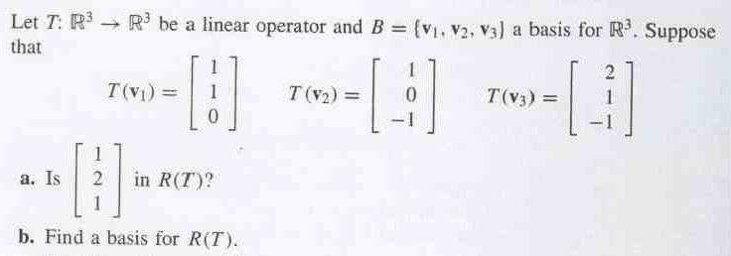
Example 11

Slide 27
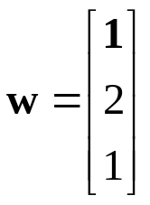

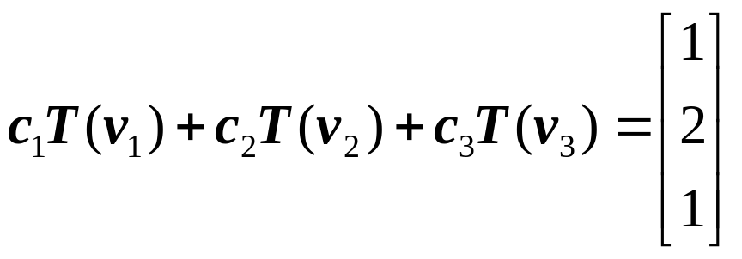
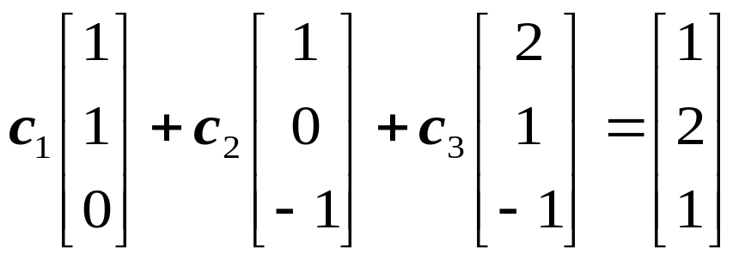
Solution
Based on the theorem, the vector is in R(T) if there are
scalars
that is

Slide 28
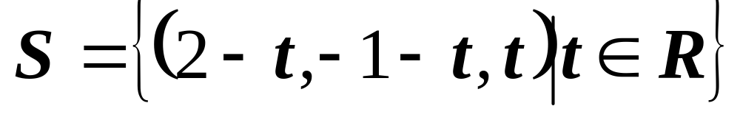
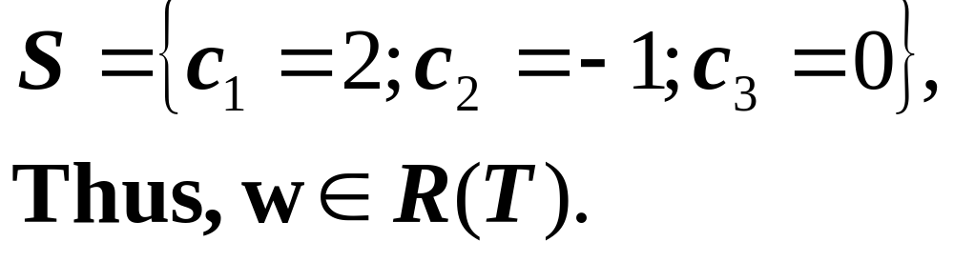
Solution (cont.)
The set of solutions to the linear systems is given by
If t = 0,

Slide 29
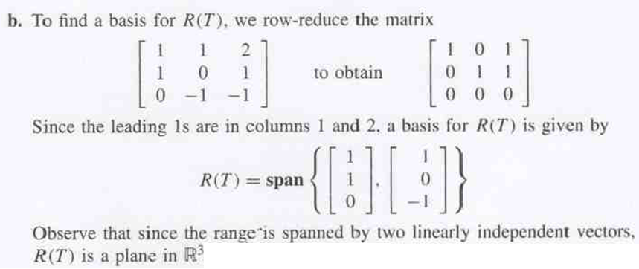
Solution (cont.)

Slide 30
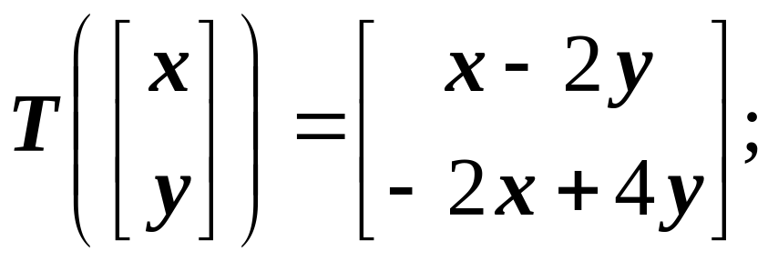
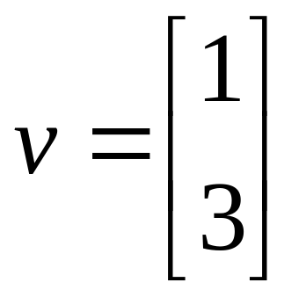
Exercises
1) Define linear operator as; T: R² → R², determine whether vector v is in N(T), where T and v are given as;

Slide 31
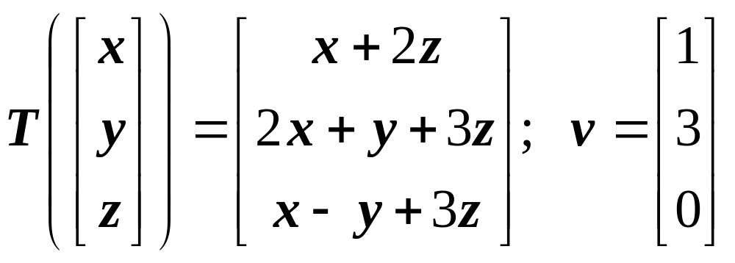
Exercises
2) Define linear operator as; T:R³ → R³, determine whether vector v is in R(T), where T and v are given as;

Slide 32
Matrix Representation of a Linear Transformation
Given any mxn matrix A, in general if T : R^{n}→R^{m} is a linear
transformation, then it is possible to write;
T(v) = Av
where A is the mxn matrix whose j^{th} column vector is
T(e_{j}) for j = 1,2,. . .n. A is called the matrix representation
of T relative to the standard bases of R^{n} and R^{m}.

Slide 33


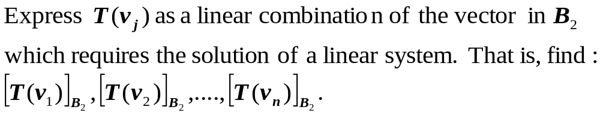
Computing matrix of a linear transformation
Based on Theorem 4.2 (module- page 116), the following steps summarize the process for finding the matrix representation of a linear transformation T:V→W relative to the ordered bases B1 and B2
For the given basis ,
compute
Find the coordinate vector
33

Slide 34
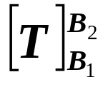
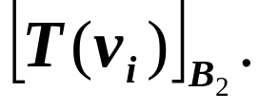
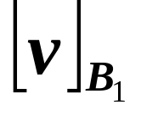

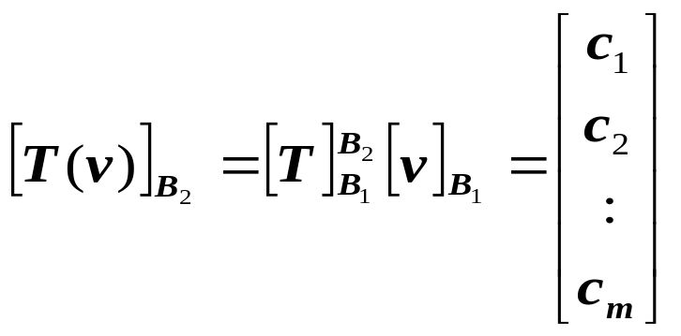

Computing matrix of a linear transformation
Define the mxn matrix with i-th column vector equal to
Compute
Compute the coordinates of
Then,

Slide 35
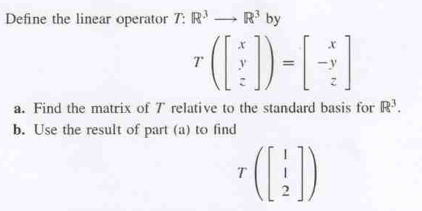
Example 12

Slide 36
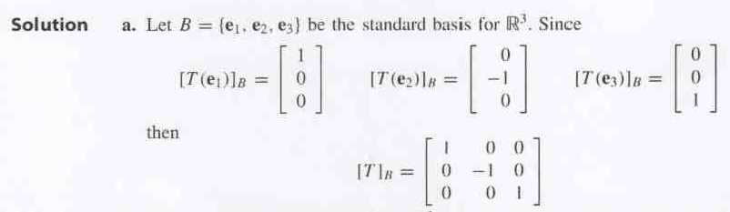
SOLUTION

Slide 37
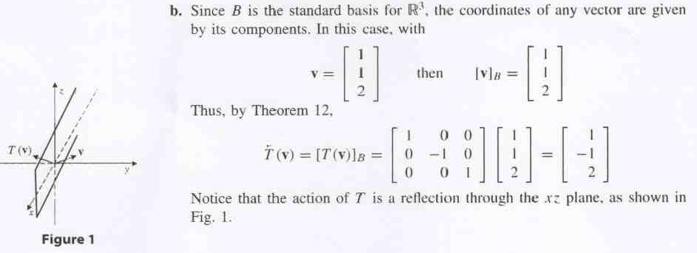
Solution (cont…)
Thus by Teorem 4.2 (module-pg.116):

Slide 38
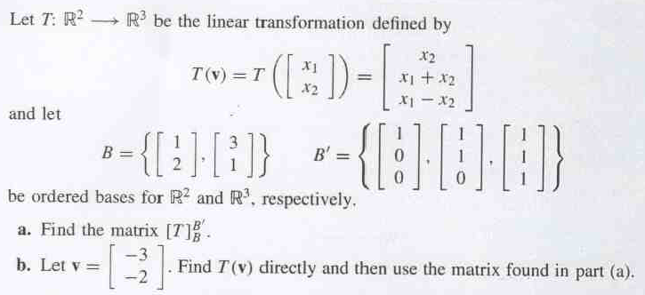
Example 13

Slide 39
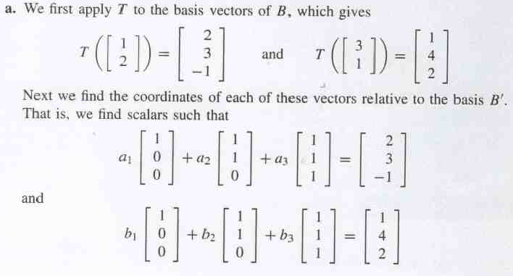
Solutions

Slide 40
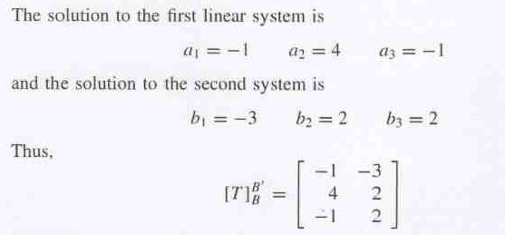
Solutions (cont..)

Slide 41
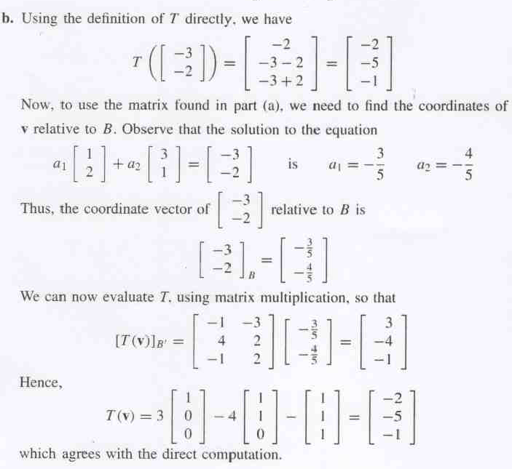
Solutions (cont..)

Slide 42

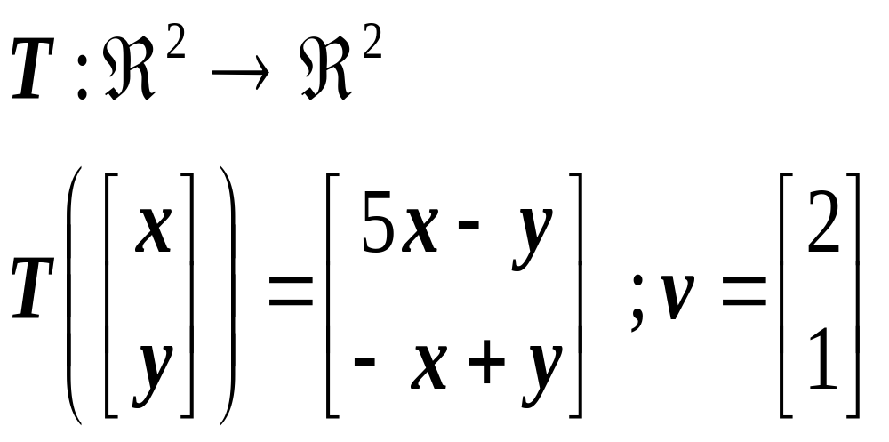
EXERCISE
is a linear operator.
Find the matrix representation for T relative to the standard
basis for .
Find T(v), using a direct computation and using the matrix
representation.

